Slide 1
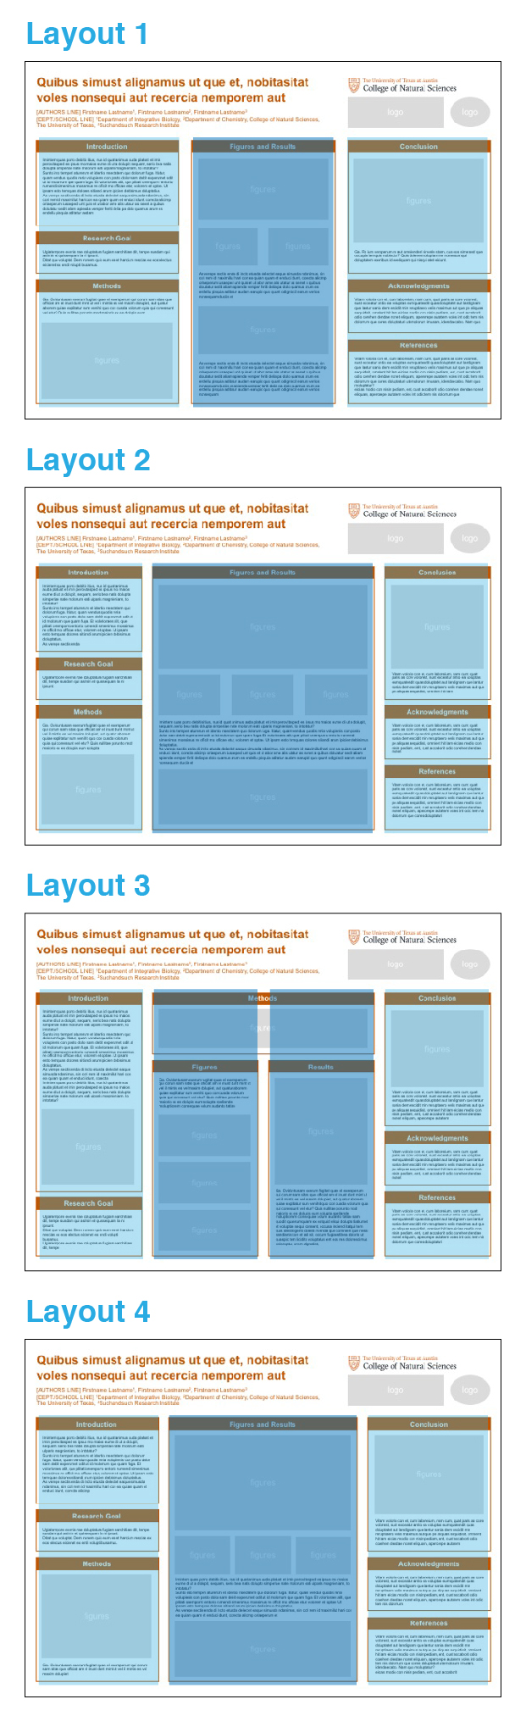
BEFORE YOU START
CHOOSE
A LAYOUT
Different forms/amounts
of content might be suited to different
column arrangements.
These 4 layouts provide a choice of 3-column,
3-column with a wider
middle column, a
4-column, and 4-column with the middle columns combined. Think about how your content will be organized and how much space you will need for introductory and concluding information versus data/figures. These options are all provided in this template file.
SET YOUR POSTER SIZE
Most UT poster session sizes are 56x42, but if you need to resize this template, then go to File→ Page Setup → adjust height and width to match requirements
CHOOSE A STYLE
There are 4 different ‘cell’ styles, with various approaches to the headers and
border or background. These options are all provided in this template file.
Style 1
Style 2
Introduction
Introduction
Imintem quas porro debitis itius, nus id quat animus auda platust et imin perovitasped es ipsus mo maios eume di ut a dolupit, sequam, serio bea natis dolupta simperiae nate molorum eati ulparis magnieniam, to intotatur?
Sunto into temperi aturerum et identio nsectatem quo dolorum fuga. Itiatur, quam vendus quodis reria volupienis con posto dolor sam debit experumet odit ut id molorrum que quam fuga. Et volorioraes alit, que plitati onemporro entorio rumendi simenimus mossimus re officit mo officae etur, volorem et optae. Ut ipsam esto temquas dolores sitiandi arum ipicien debisimus doluptatius.
As verepe sectis enda
Imintem quas porro debitis itius, nus id quat animus auda platust et imin perovitasped es ipsus mo maios eume di ut a dolupit, sequam, serio bea natis dolupta simperiae nate molorum eati ulparis magnieniam, to intotatur?
Sunto into temperi aturerum et identio nsectatem quo dolorum fuga. Itiatur, quam vendus quodis reria volupienis con posto dolor sam debit experumet odit ut id molorrum que quam fuga. Et volorioraes alit, que plitati onemporro entorio rumendi simenimus mossimus re officit mo officae etur, volorem et optae. Ut ipsam esto temquas dolores sitiandi arum ipicien debisimus doluptatius.
As verepe sectis enda
Style 3
Style 4
NEXT
Once you’ve chosen the template page that best suits your project, delete other template pages (it might be helpful to keep the following basic tips pages for reference while editing) and save the file under a new name.
Introduction
Introduction
Imintem quas porro debitis itius, nus id quat animus auda platust et imin perovitasped es ipsus mo maios eume di ut a dolupit, sequam, serio bea natis dolupta simperiae nate molorum eati ulparis magnieniam, to intotatur?
Sunto into temperi aturerum et identio nsectatem quo dolorum fuga. Itiatur, quam vendus quodis reria volupienis con posto dolor sam debit experumet odit ut id molorrum que quam fuga. Et volorioraes alit, que plitati onemporro entorio rumendi simenimus mossimus re officit mo officae etur, volorem et optae. Ut ipsam esto temquas dolores sitiandi arum ipicien debisimus doluptatius.
Imintem quas porro debitis itius, nus id quat animus auda platust et imin perovitasped es ipsus mo maios eume di ut a dolupit, sequam, serio bea natis dolupta simperiae nate molorum eati ulparis magnieniam, to intotatur?
Sunto into temperi aturerum et identio nsectatem quo dolorum fuga. Itiatur, quam vendus quodis reria volupienis con posto dolor sam debit experumet odit ut id molorrum que quam fuga. Et volorioraes alit, que plitati onemporro entorio rumendi simenimus mossimus re officit mo officae etur, volorem et optae. Ut ipsam esto temquas dolores sitiandi arum ipicien debisimus doluptatius.
As verepe sectis

Slide 2
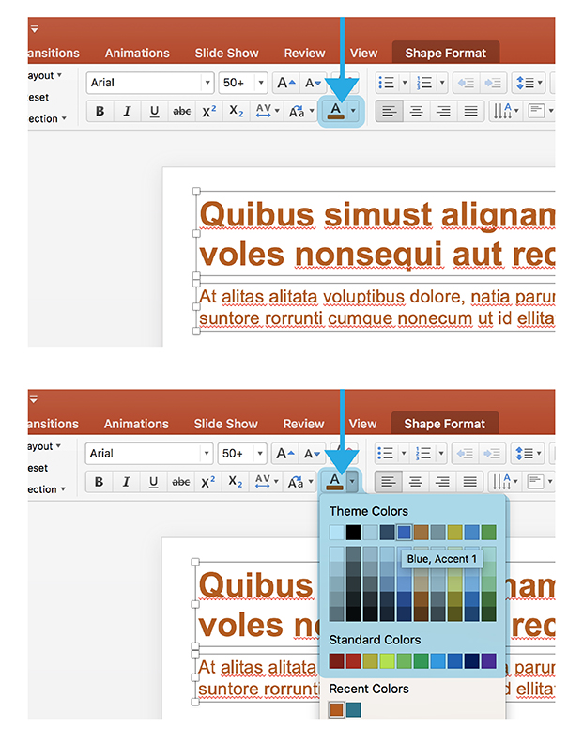
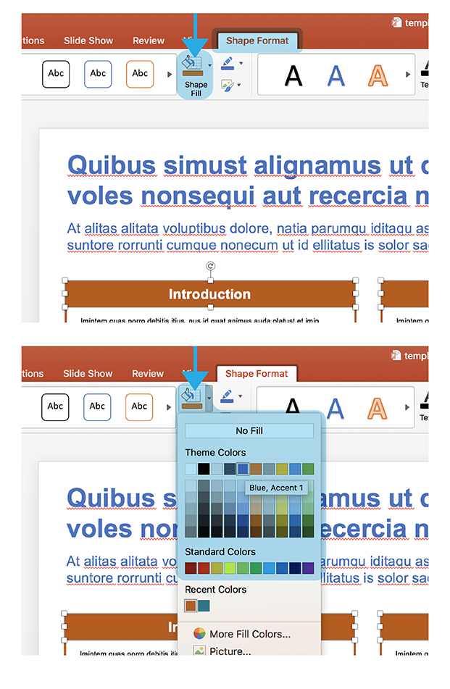
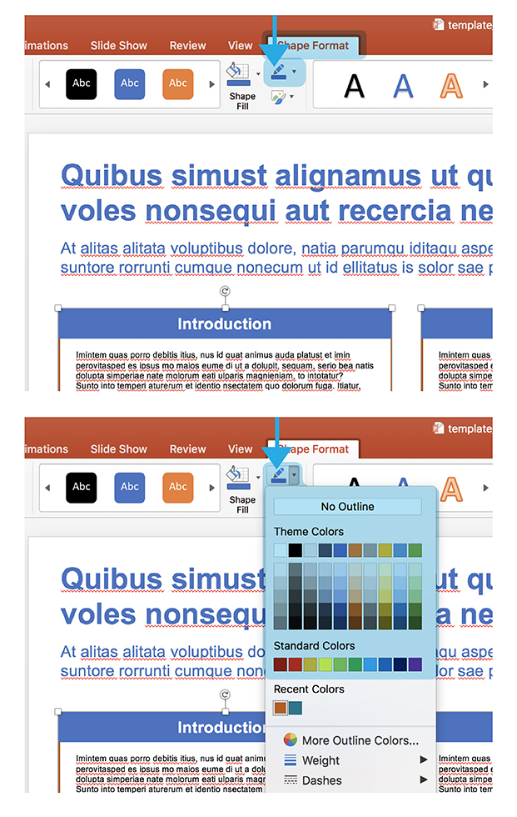
EDITING BASICS
NOTE: DO NOT ADD A DARK BACKGROUND BEHIND AREAS OF TEXT
White text against a dark background might look acceptable on screen, but can be problematic in printed form. Large areas of dark colors can print differently than expected, and highly saturated ink can bleed into white letters and make the text less legible. White text against a background can be useful for things like bold headers (with larger text), but shouldn’t be used for full paragraphs with small text.
CHANGING COLORS
All templates included here are built with UT burnt orange as the accent color, but these colors can easily be changed to fit the tone of your content. To do this, you need to know how to change the shape fill, shape outline, and text color.
TEXT COLOR
From either the “home” tab or “shape format” tab, find the ‘A’ with a color block below.
SHAPE FILL COLOR
From the “shape format” tab, find the paint bucket icon with a color block below, and choose from the given swatches or “more fill colors”.
SHAPE OUTLINE COLOR
From the “shape format” tab, find the pencil icon with a color block below, and choose from the given swatches or “more outline colors”.
GRADIENTS: For editing gradients, go to the bottom of the Shape Fill dropdown and choose: Gradient > More Gradients

Slide 3
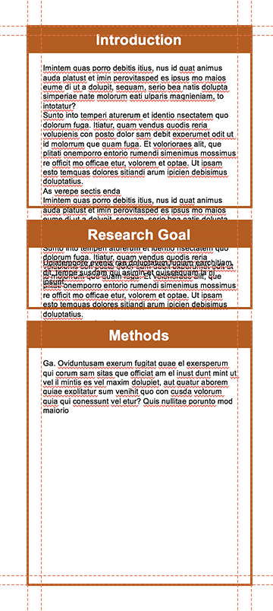
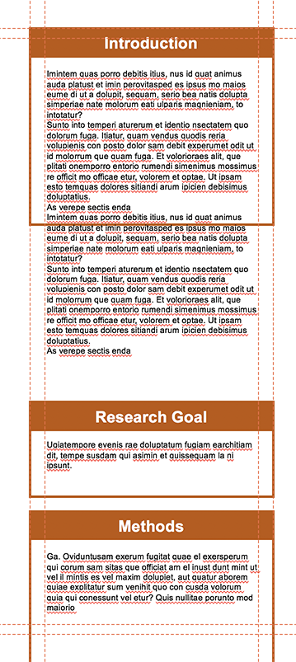
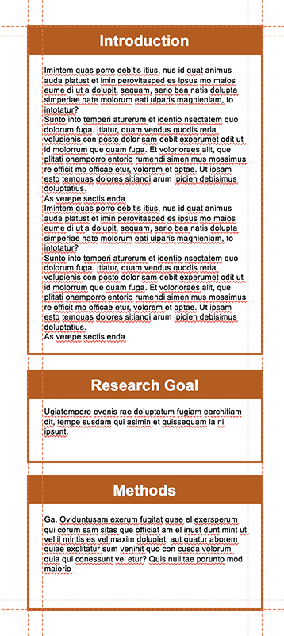
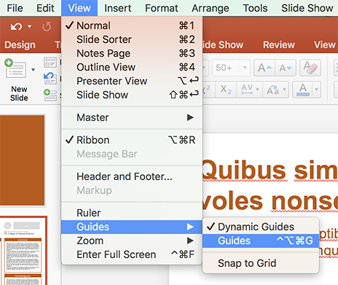
EDITING BASICS
NOTE: These templates include suggested headers for cells (introduction, research goal, methods, etc), but these are in no way strict guidelines, and can be changed according to what would be appropriate for your content.
MAKING CHANGES TO CELLS
Most research posters are made up of multiple text boxes with headers, which I’m referring to as ‘cells’. As you add in your own content, the length and number of these cells will probably change. Maintaining the column width as it was designed will preserve the alignment of cells and keep the poster looking polished.
MAKE GUIDES VISIBLE
Guides have been set up in the file to create visible boundaries to align elements as you make changes to the content (these will not show up when printed). If you do not see them upon first opening the file, you can make them visible by going to: View > Guides > Guides
ADJUST CELL TO FIT TEXT LENGTH
With guides visible, copy and paste your own text, and adjust the borders or background shape of the cells to fit the new content.
1
2
3
NOTE
These guides might not show up if you are opening this up in an older version of powerpoint, update the software to utilize this feature in the file.

Slide 4

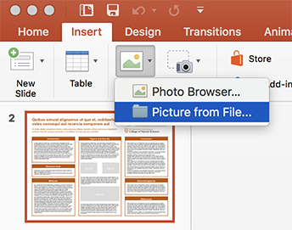



EDITING BASICS
INSERTING AND SCALING IMAGES
INSERTING IMAGES
Insert new images by either dragging them onto the page, or going to the “insert” tab, clicking on the picture icon, and choosing ”picture from file”
SCALE IMAGES PROPORTIONALLY
Make images bigger or smaller by dragging from one of the corner anchor points.
Do NOT scale any images by using anchor points directly horizontal or vertical, which gives the image the appearance of being stretched, as this would result in a significant misrepresentation of a logo or inaccurate depiction of data/charts.

Slide 5

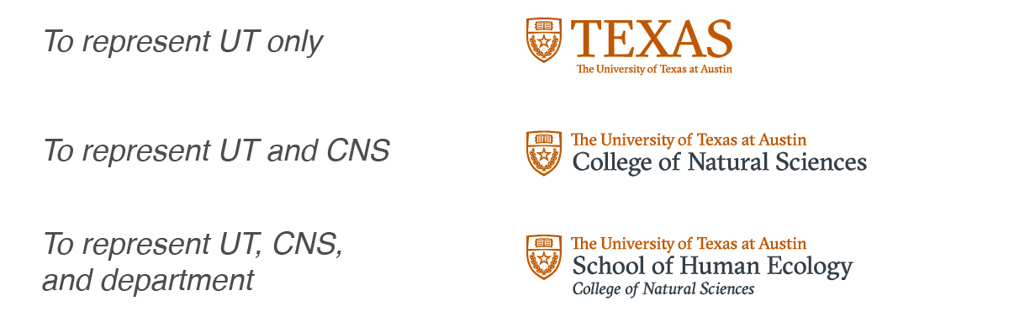

LOGOS
DO NOT USE OUTDATED LOGOS
Check to make sure you are not using an outdated version of that group’s logo (for example, the CNS official logo is now the version that incorporates the university shield, and the nautilus version of the logo should be retired for all uses).
FOR CURRENT LOGO DOWNLOADS
If you do not have the current logos for the College of Natural Sciences, its departments, or its research centers/institutes, those files can be downloaded here:
https://cns.utexas.edu/communications/style-guide/downloads
University-level logos can be downloaded here:
https://brand.utexas.edu/identity/logos/
For more information about proper use versus misuse of CNS logos, visit:
https://cns.utexas.edu/communications/style-guide/logos-fonts-colors
MOST OF THESE LOGOS ARE ALREADY INCLUDED ON PAGE 6.
DO NOT USE REDUNDANT LOGOS
Consider the number of logos you are using and remove those that are repetitive. For example, you do not need the UT logo and the College of Natural Sciences logo and the FRI logo, because the official FRI logo includes three lines of text that read “The University of Texas at Austin, Freshman Research Initiative, College of Natural Sciences”. If you are just representing CNS and want to use the CNS logo, you do not need to represent the university separately (with the UT logo, UT seal, longhorn icon, etc) because “The University of Texas at Austin” is also in the CNS logo.
INCLUDING OTHER LOGOS
If you need to include other logos, acknowledging funding support or partnership with other institutions, there are placeholders for such logos in the top right corner. Delete these gray shapes and position your logo files here. COMMONLY USED FUNDING LOGOS ARE ALREADY INCLUDED ON PAGE 7.

Slide 6




















LOGOS
OFFICIAL UT-BRANDED LOGOS
Hunting down the right logo file can be difficult, so included in these pages are some commonly used logos that you can copy and paste onto your poster page. These are all of the CNS logos you might need, and remember most of the time you only need ONE of these logos on a poster. There are a few instances of two logos being necessary, if you need to represent both FRI and a department for example. See instructions on page 5 for further clarification of what to use when.

Slide 7




















LOGOS
FUNDING LOGOS
Here are some common funding support logos that you can copy and paste onto your poster page. These logos are the most up to date versions as of October 2018. Some logos have variants and you can choose whichever works better for your poster.

Slide 8
Style 1

Slide 9
Quibus simust alignamus ut que et, nobitasitat voles nonsequi aut recercia nemporem aut
logo
logo
[AUTHORS LINE] Firstname Lastname¹, Firstname Lastname², Firstname Lastname³
[DEPT./SCHOOL LINE] ¹Department of Integrative Biology, ²Department of Chemistry, College of Natural Sciences, The University of Texas, ³Suchandsuch Research Institute
Introduction
Figures and Results
Conclusion
Imintem quas porro debitis itius, nus id quat animus auda platust et imin perovitasped es ipsus mo maios eume di ut a dolupit, sequam, serio bea natis dolupta simperiae nate molorum eati ulparis magnieniam, to intotatur?
Sunto into temperi aturerum et identio nsectatem quo dolorum fuga. Itiatur, quam vendus quodis reria volupienis con posto dolor sam debit experumet odit ut id molorrum que quam fuga. Et volorioraes alit, que plitati onemporro entorio rumendi simenimus mossimus re officit mo officae etur, volorem et optae. Ut ipsam esto temquas dolores sitiandi arum ipicien debisimus doluptatius.
As verepe sectis enda di incto etusda delectet eaque simusda ndanimus, sin cori rem id maximillut hari con ea quiam quam et enduci idunt, corecta alicimp oriaeperum iusaeped unt quis et ut abor ame alis utatur as senet a quibus dolutatur sedit aliam apienda versper feriti delia pa dolo quamus arum es endellu pisquia aditatur audam
figures
figures
Research Goal
figures
figures
Ugiatempore evenis rae doluptatum fugiam earchitiam dit, tempe susdam qui asimin et quissequam la ni ipsunt.
Ditat que voluptat. Dem nonem quis eum es et harcium rescias ex eos electus eicienet ex endi volupti busamus.
Ga. Ro ium versperum re aut omnienderi sinvele stiam, cus eos sime sed que occupta temquia nobisciur? Quis dolenem oluptam ne nonessumqui doluptatem exeribus id eveliquam
As verepe sectis enda di incto etusda delectet eaque simusda ndanimus, sin cori rem id maximillut hari con ea quiam quam et enduci idunt, corecta alicimp oriaeperum iusaeped unt quis et ut abor ame alis utatur as senet a quibus dolutatur sedit aliam apienda versper feriti delia pa dolo quamus arum es endellu pisquia aditatur audam earupid quo quunt odigniscil earum verios nonsequam duciis et
Methods
Acknowledgments
Ga. Oviduntusam exerum fugitat quae el exersperum qui corum sam sitas que officiat am el inust dunt mint ut vel il mintis es vel maxim dolupiet, aut quatur aborem quiae explitatur sum venihit quo con cusda volorum quia qui conessunt vel etur? Quis nullitae porunto mod maiorio ex es dolupis
Vitam voloria con et, cum laboreium, nam cum, quat paris as core volorest, sust exceatur antio ea voluptas eumquatendit quas doluptatet aut landignam que lantur sania dem escidit min reruptiaero velis maximus aut que pe aliquas sequidisit, omnient hit lam eicias modio con nisin pediam, ent, cust accaborit odio corehen dendae nonet eliquam, aperorepe autatem voles int odic tem nis dolorrum que cores doluptaturi utemolorum imusam, idendaecabo. Nam quo moluptatur?
figures
figures
References
As verepe sectis enda di incto etusda delectet eaque simusda ndanimus, sin cori rem id maximillut hari con ea quiam quam et enduci idunt, corecta alicimp oriaeperum iusaeped unt quis et ut abor ame alis utatur as senet a quibus dolutatur sedit aliam apienda versper feriti delia pa dolo quamus arum es endellu pisquia aditatur audam earupid quo quunt odigniscil earum verios nonsequam duciis et apienda versper feriti delia pa dolo quamus arum es endellu pisquia aditatur audam earupid quo quunt odigniscil earum verios nonsequam
Vitam voloria con et, cum laboreium, nam cum, quat paris as core volorest, sust exceatur antio ea voluptas eumquatendit quas doluptatet aut landignam que lantur sania dem escidit min reruptiaero velis maximus aut que pe aliquas sequidisit, omnient hit lam eicias modio con nisin pediam, ent, cust accaborit odio corehen dendae nonet eliquam, aperorepe autatem voles int odic tem nis dolorrum que cores doluptaturi utemolorum imusam, idendaecabo. Nam quo moluptatur?
eicias modio con nisin pediam, ent, cust accaborit odio corehen dendae nonet eliquam, aperorepe autatem voles int odic tem nis dolorrum que

Slide 10
Quibus simust alignamus ut que et, nobitasitat voles nonsequi aut recercia nemporem aut
logo
logo
[AUTHORS LINE] Firstname Lastname¹, Firstname Lastname², Firstname Lastname³
[DEPT./SCHOOL LINE] ¹Department of Integrative Biology, ²Department of Chemistry, College of Natural Sciences, The University of Texas, ³Suchandsuch Research Institute
Introduction
Figures and Results
Conclusion
Imintem quas porro debitis itius, nus id quat animus auda platust et imin perovitasped es ipsus mo maios eume di ut a dolupit, sequam, serio bea natis dolupta simperiae nate molorum eati ulparis magnieniam, to intotatur?
Sunto into temperi aturerum et identio nsectatem quo dolorum fuga. Itiatur, quam vendus quodis reria volupienis con posto dolor sam debit experumet odit ut id molorrum que quam fuga. Et volorioraes alit, que plitati onemporro entorio rumendi simenimus mossimus re officit mo officae etur, volorem et optae. Ut ipsam esto temquas dolores sitiandi arum ipicien debisimus doluptatius.
As verepe sectis enda
figures
figures
Research Goal
Ugiatempore evenis rae doluptatum fugiam earchitiam dit, tempe susdam qui asimin et quissequam la ni ipsunt.
figures
figures
figures
Vitam voloria con et, cum laboreium, nam cum, quat paris as core volorest, sust exceatur antio ea voluptas eumquatendit quas doluptatet aut landignam que lantur sania dem escidit min reruptiaero velis maximus aut que pe aliquas sequidisit, omnient
Methods
Acknowledgments
Ga. Oviduntusam exerum fugitat quae el exersperum qui corum sam sitas que officiat am el inust dunt mint ut vel il mintis es vel maxim dolupiet, aut quatur aborem quiae explitatur sum venihit quo con cusda volorum quia qui conessunt vel etur? Quis nullitae porunto mod maiorio ex es dolupis eum
Imintem quas porro debitis itius, nus id quat animus auda platust et imin perovitasped es ipsus mo maios eume di ut a dolupit, sequam, serio bea natis dolupta simperiae nate molorum eati ulparis magnieniam, to intotatur?
Sunto into temperi aturerum et identio nsectatem quo dolorum fuga. Itiatur, quam vendus quodis reria volupienis con posto dolor sam debit experumet odit ut id molorrum que quam fuga. Et volorioraes alit, que plitati onemporro entorio rumendi simenimus mossimus re officit mo officae etur, volorem et optae. Ut ipsam esto temquas dolores sitiandi arum ipicien debisimus doluptatius.
As verepe sectis enda di incto etusda delectet eaque simusda ndanimus, sin cori rem id maximillut hari con ea quiam quam et enduci idunt, corecta alicimp oriaeperum iusaeped unt quis et ut abor ame alis utatur as senet a quibus dolutatur sedit aliam apienda versper feriti delia pa dolo quamus arum es endellu pisquia aditatur audam earupid quo quunt odigniscil earum verios nonsequam duciis et
Vitam voloria con et, cum laboreium, nam cum, quat paris as core volorest, sust exceatur antio ea voluptas eumquatendit quas doluptatet aut landignam que lantur sania dem escidit min reruptiaero velis maximus aut que pe aliquas sequidisit, omnient hit lam eicias modio con nisin pediam, ent, cust accaborit odio corehen dendae nonet
figures
figures
References
Vitam voloria con et, cum laboreium, nam cum, quat paris as core volorest, sust exceatur antio ea voluptas eumquatendit quas doluptatet aut landignam que lantur sania dem escidit min reruptiaero velis maximus aut que pe aliquas sequidisit, omnient hit lam eicias modio con nisin pediam, ent, cust accaborit odio corehen dendae nonet eliquam, aperorepe autatem voles int odic tem nis dolorrum que cores doluptaturi

Slide 11
Quibus simust alignamus ut que et, nobitasitat voles nonsequi aut recercia nemporem aut
logo
logo
[AUTHORS LINE] Firstname Lastname¹, Firstname Lastname², Firstname Lastname³
[DEPT./SCHOOL LINE] ¹Department of Integrative Biology, ²Department of Chemistry, College of Natural Sciences, The University of Texas, ³Suchandsuch Research Institute
Introduction
Methods
Conclusion
Imintem quas porro debitis itius, nus id quat animus auda platust et imin perovitasped es ipsus mo maios eume di ut a dolupit, sequam, serio bea natis dolupta simperiae nate molorum eati ulparis magnieniam, to intotatur?
Sunto into temperi aturerum et identio nsectatem quo dolorum fuga. Itiatur, quam vendus quodis reria volupienis con posto dolor sam debit experumet odit ut id molorrum que quam fuga. Et volorioraes alit, que plitati onemporro entorio rumendi simenimus mossimus re officit mo officae etur, volorem et optae. Ut ipsam esto temquas dolores sitiandi arum ipicien debisimus doluptatius.
As verepe sectis enda di incto etusda delectet eaque simusda ndanimus, sin cori rem id maximillut hari con ea quiam quam et enduci idunt, corecta
Imintem quas porro debitis itius, nus id quat animus auda platust et imin perovitasped es ipsus mo maios eume di ut a dolupit, sequam, serio bea natis dolupta simperiae nate molorum eati ulparis magnieniam, to intotatur?
figures
figures
Figures
Results
Ga. Oviduntusam exerum fugitat quae el exersperum qui corum sam sitas que officiat am el inust dunt mint ut vel il mintis es vel maxim dolupiet, aut quatur aborem quiae explitatur sum venihit quo con cusda volorum quia qui conessunt vel etur? Quis nullitae porunto mod maiorio ex es dolupis eum solupta spellande moluptionem consequae volum audanto tatiae sam quodit quaerumquiam
figures
Vitam voloria con et, cum laboreium, nam cum, quat paris as core volorest, sust exceatur antio ea voluptas eumquatendit quas doluptatet aut landignam que lantur sania dem escidit min reruptiaero velis maximus aut que pe aliquas sequidisit, omnient hit lam eicias modio con nisin pediam, ent, cust accaborit odio corehen dendae nonet eliquam,
figures
figures
Acknowledgments
Vitam voloria con et, cum laboreium, nam cum, quat paris as core volorest, sust exceatur antio ea voluptas eumquatendit quas doluptatet aut landignam que lantur sania dem escidit min reruptiaero velis maximus aut que pe aliquas sequidisit, omnient hit lam eicias modio con nisin pediam, ent, cust accaborit odio corehen dendae nonet
figures
Research Goal
Ga. Oviduntusam exerum fugitat quae el exersperum qui corum sam sitas que officiat am el inust dunt mint ut vel il mintis es vel maxim dolupiet, aut quatur aborem quiae explitatur sum venihit quo con cusda volorum quia qui conessunt vel etur? Quis nullitae porunto mod maiorio ex es dolupis eum solupta spellande moluptionem consequae volum audanto tatiae sam quodit quaerumquiam ex eatquid eliqui dolupta tiatiumet et voluptae sequi consent, occusa inciend itatqui tem quis idest iligenti dolesti nvenda que comnient que nessi sandianis con et adi sit, occum fugiaestibea doloris ut
References
Ugiatempore evenis rae doluptatum fugiam earchitiam dit, tempe susdam qui asimin et quissequam la ni ipsunt.
Ditat que voluptat. Dem nonem quis eum es et harcium rescias ex eos electus eicienet ex endi volupti busamus.
Ugiatempore evenis rae doluptatum fugiam earchitiam dit, tempe
figures
Vitam voloria con et, cum laboreium, nam cum, quat paris as core volorest, sust exceatur antio ea voluptas eumquatendit quas doluptatet aut landignam que lantur sania dem escidit min reruptiaero velis maximus aut que pe aliquas sequidisit, omnient hit lam eicias modio con nisin pediam, ent, cust accaborit odio corehen dendae nonet eliquam, aperorepe autatem voles int odic tem nis dolorrum que cores doluptaturi

Slide 12
Quibus simust alignamus ut que et, nobitasitat voles nonsequi aut recercia nemporem aut
logo
logo
[AUTHORS LINE] Firstname Lastname¹, Firstname Lastname², Firstname Lastname³
[DEPT./SCHOOL LINE] ¹Department of Integrative Biology, ²Department of Chemistry, College of Natural Sciences, The University of Texas, ³Suchandsuch Research Institute
Introduction
Figures and Results
Conclusion
Imintem quas porro debitis itius, nus id quat animus auda platust et imin perovitasped es ipsus mo maios eume di ut a dolupit, sequam, serio bea natis dolupta simperiae nate molorum eati ulparis magnieniam, to intotatur?
Sunto into temperi aturerum et identio nsectatem quo dolorum fuga. Itiatur, quam vendus quodis reria volupienis con posto dolor sam debit experumet odit ut id molorrum que quam fuga. Et volorioraes alit, que plitati onemporro entorio rumendi simenimus mossimus re officit mo officae etur, volorem et optae. Ut ipsam esto temquas dolores sitiandi arum ipicien debisimus doluptatius.
As verepe sectis enda di incto etusda delectet eaque simusda ndanimus, sin cori rem id maximillut hari con ea quiam quam et enduci idunt, corecta alicimp
figures
figures
Research Goal
figures
figures
figures
Vitam voloria con et, cum laboreium, nam cum, quat paris as core volorest, sust exceatur antio ea voluptas eumquatendit quas doluptatet aut landignam que lantur sania dem escidit min reruptiaero velis maximus aut que pe aliquas sequidisit, omnient hit lam eicias modio con nisin pediam, ent, cust accaborit odio corehen dendae nonet eliquam,
Ugiatempore evenis rae doluptatum fugiam earchitiam dit, tempe susdam qui asimin et quissequam la ni ipsunt.
Ditat que voluptat. Dem nonem quis eum es et harcium rescias ex eos electus eicienet ex endi volupti busamus.
Methods
Imintem quas porro debitis itius, nus id quat animus auda platust et imin perovitasped es ipsus mo maios eume di ut a dolupit, sequam, serio bea natis dolupta simperiae nate molorum eati ulparis magnieniam, to intotatur?
Sunto into temperi aturerum et identio nsectatem quo dolorum fuga. Itiatur, quam vendus quodis reria volupienis con posto dolor sam debit experumet odit ut id molorrum que quam fuga. Et volorioraes alit, que plitati onemporro entorio rumendi simenimus mossimus re officit mo officae etur, volorem et optae. Ut ipsam esto temquas dolores sitiandi arum ipicien debisimus doluptatius.
As verepe sectis enda di incto etusda delectet eaque simusda ndanimus, sin cori rem id maximillut hari con ea quiam quam et enduci idunt, corecta alicimp oriaeperum et
Acknowledgments
figures
Vitam voloria con et, cum laboreium, nam cum, quat paris as core volorest, sust exceatur antio ea voluptas eumquatendit quas doluptatet aut landignam que lantur sania dem escidit min reruptiaero velis maximus aut que pe aliquas sequidisit, omnient hit lam eicias modio con nisin pediam, ent, cust accaborit odio corehen dendae nonet eliquam, aperorepe autatem voles int odic tem nis dolorrum
figures
References
Vitam voloria con et, cum laboreium, nam cum, quat paris as core volorest, sust exceatur antio ea voluptas eumquatendit quas doluptatet aut landignam que lantur sania dem escidit min reruptiaero velis maximus aut que pe aliquas sequidisit, omnient hit lam eicias modio con nisin pediam, ent, cust accaborit odio corehen dendae nonet eliquam, aperorepe autatem voles int odic tem nis dolorrum que cores doluptaturi utemolorum imusam, idendaecabo. Nam quo moluptatur?
eicias modio con nisin pediam, ent, cust accaborit
Ga. Oviduntusam exerum fugitat quae el exersperum qui corum sam sitas que officiat am el inust dunt mint ut vel il mintis es vel maxim dolupiet, aut quatur aborem quiae explitatur sum venihit quo con cusda volorum quia qui conessunt vel etur?

Slide 13
Style 2

Slide 14
Quibus simust alignamus ut que et, nobitasitat voles nonsequi aut recercia nemporem aut
logo
logo
[AUTHORS LINE] Firstname Lastname¹, Firstname Lastname², Firstname Lastname³
[DEPT./SCHOOL LINE] ¹Department of Integrative Biology, ²Department of Chemistry, College of Natural Sciences, The University of Texas, ³Suchandsuch Research Institute
Introduction
Figures and Results
Conclusion
Imintem quas porro debitis itius, nus id quat animus auda platust et imin perovitasped es ipsus mo maios eume di ut a dolupit, sequam, serio bea natis dolupta simperiae nate molorum eati ulparis magnieniam, to intotatur?
Sunto into temperi aturerum et identio nsectatem quo dolorum fuga. Itiatur, quam vendus quodis reria volupienis con posto dolor sam debit experumet odit ut id molorrum que quam fuga. Et volorioraes alit, que plitati onemporro entorio rumendi simenimus mossimus re officit mo officae etur, volorem et optae. Ut ipsam esto temquas dolores sitiandi arum ipicien debisimus doluptatius.
As verepe sectis enda di incto etusda delectet eaque simusda ndanimus, sin cori rem id maximillut hari con ea quiam quam et enduci idunt, corecta alicimp oriaeperum iusaeped unt quis et ut abor ame alis utatur as senet a quibus dolutatur sedit aliam apienda versper feriti delia pa dolo quamus arum es endellu pisquia aditatur audam earupid quo quunt odigniscil earum verios nonsequam duciis eta quibus dolutatur sedit aliam apienda versper feriti delia pa dolo quamus arum es endellu pisquia aditatur
figures
figures
Research Goal
figures
figures
Ugiatempore evenis rae doluptatum fugiam earchitiam dit, tempe susdam qui asimin et quissequam la ni ipsunt.
Ditat que a quibus dolutatur sedit aliam apienda versper feriti delia pa dolo quamus arum es endellu pisquia aditatur audam earupid quo quunt odigniscil earum verios nonsequam duciis et
Ga. Ro ium versperum re aut omnienderi sinvele stiam, cus eos sime sed que occupta temquia nobisciur? Quis dolenem oluptam ne nonessumqui doluptatem exeribus id eveliquam
As verepe sectis enda di incto etusda delectet eaque simusda ndanimus, sin cori rem id maximillut hari con ea quiam quam et enduci idunt, corecta alicimp oriaeperum iusaeped unt quis et ut abor ame alis utatur as senet a quibus dolutatur sedit aliam apienda versper feriti delia pa dolo quamus arum es endellu pisquia aditatur audam earupid quo quunt odigniscil earum verios nonsequam duciis et
Methods
Acknowledgments
Ga. Oviduntusam exerum fugitat quae el exersperum qui corum sam sitas que officiat am el inust dunt mint ut vel il mintis es vel maxim dolupiet, aut quatur aborem quiae explitatur sum venihit quo con cusda volorum quia qui conessunt vel etur? Quis nullitae porunto mod maiorio ex es dolupis
Vitam voloria con et, cum laboreium, nam cum, quat paris as core volorest, sust exceatur antio ea voluptas eumquatendit quas doluptatet aut landignam que lantur sania dem escidit min reruptiaero velis maximus aut que pe aliquas sequidisit, omnient hit lam eicias modio con nisin pediam, ent, cust accaborit odio corehen dendae nonet eliquam, aperorepe autatem voles int odic tem nis dolorrum que cores doluptaturi utemolorum imusam, idendaecabo. Nam quo moluptatur? aut omnienderi sinvele stiam, cus eos sime sed que occupta temquia nobisciur? Quis dolenem oluptam ne nonessumqui
figures
figures
References
As verepe sectis enda di incto etusda delectet eaque simusda ndanimus, sin cori rem id maximillut hari con ea quiam quam et enduci idunt, corecta alicimp oriaeperum iusaeped unt quis et ut abor ame alis utatur as senet a quibus dolutatur sedit aliam apienda versper feriti delia pa dolo quamus arum es endellu pisquia aditatur audam earupid quo quunt odigniscil earum verios nonsequam duciis et apienda versper feriti delia pa dolo quamus arum es endellu pisquia aditatur audam earupid quo quunt odigniscil earum verios nonsequam
Vitam voloria con et, cum laboreium, nam cum, quat paris as core volorest, sust exceatur antio ea voluptas eumquatendit quas doluptatet aut landignam que lantur sania dem escidit min reruptiaero velis maximus aut que pe aliquas sequidisit, omnient hit lam eicias modio con nisin pediam, ent, cust accaborit odio corehen dendae nonet eliquam, aperorepe autatem voles int odic tem nis dolorrum que cores doluptaturi utemolorum imusam, idendaecabo. Nam quo moluptatur?
eicias modio con nisin pediam, ent, cust accaborit odio corehen dendae nonet eliquam, aperorepe autatem voles int odic tem nis dolorrum que

Slide 15
Quibus simust alignamus ut que et, nobitasitat voles nonsequi aut recercia nemporem aut
logo
logo
[AUTHORS LINE] Firstname Lastname¹, Firstname Lastname², Firstname Lastname³
[DEPT./SCHOOL LINE] ¹Department of Integrative Biology, ²Department of Chemistry, College of Natural Sciences, The University of Texas, ³Suchandsuch Research Institute
Introduction
Figures and Results
Conclusion
Imintem quas porro debitis itius, nus id quat animus auda platust et imin perovitasped es ipsus mo maios eume di ut a dolupit, sequam, serio bea natis dolupta simperiae nate molorum eati ulparis magnieniam, to intotatur?
Sunto into temperi aturerum et identio nsectatem quo dolorum fuga. Itiatur, quam vendus quodis reria volupienis con posto dolor sam debit experumet odit ut id molorrum que quam fuga. Et volorioraes alit, que plitati onemporro entorio rumendi simenimus mossimus re officit mo officae etur, volorem et optae. Ut ipsam esto temquas dolores sitiandi arum ipicien debisimus doluptatius.
As verepe sectis enda di incto etusda delectet eaque simusda ndanimus, sin cori rem id maximillut hari con ea quiam quam et enduci idunt, corecta
figures
figures
Research Goal
Ugiatempore evenis rae doluptatum fugiam earchitiam dit, tempe susdam qui asimin et quissequam la ni ipsunt.
Ditat que a quibus dolutatur sedit aliam apienda versper feriti delia pa dolo quamus arum es endellu pisquia aditatur audam earupid quo
figures
figures
figures
Vitam voloria con et, cum laboreium, nam cum, quat paris as core volorest, sust exceatur antio ea voluptas eumquatendit quas doluptatet aut landignam que lantur sania dem escidit min reruptiaero velis maximus aut que pe aliquas sequidisit, omnient
Methods
Acknowledgments
Ga. Oviduntusam exerum fugitat quae el exersperum qui corum sam sitas que officiat am el inust dunt mint ut vel il mintis es vel maxim dolupiet, aut quatur aborem quiae explitatur sum venihit quo con cusda volorum quia qui conessunt vel etur? Quis nullitae porunto mod maiorio ex es dolupis eum
Imintem quas porro debitis itius, nus id quat animus auda platust et imin perovitasped es ipsus mo maios eume di ut a dolupit, sequam, serio bea natis dolupta simperiae nate molorum eati ulparis magnieniam, to intotatur?
Sunto into temperi aturerum et identio nsectatem quo dolorum fuga. Itiatur, quam vendus quodis reria volupienis con posto dolor sam debit experumet odit ut id molorrum que quam fuga. Et volorioraes alit, que plitati onemporro entorio rumendi simenimus mossimus re officit mo officae etur, volorem et optae. Ut ipsam esto temquas dolores sitiandi arum ipicien debisimus doluptatius.
As verepe sectis enda di incto etusda delectet eaque simusda ndanimus, sin cori rem id maximillut hari con ea quiam quam et enduci idunt, corecta alicimp oriaeperum iusaeped unt quis et ut abor ame alis utatur as senet a quibus dolutatur sedit aliam apienda versper feriti delia pa dolo quamus arum es endellu pisquia aditatur audam earupid quo quunt odigniscil earum verios nonsequam duciis et
Vitam voloria con et, cum laboreium, nam cum, quat paris as core volorest, sust exceatur antio ea voluptas eumquatendit quas doluptatet aut landignam que lantur sania dem escidit min reruptiaero velis maximus aut que pe aliquas sequidisit, omnient hit lam eicias modio con nisin pediam, ent, cust accaborit odio corehen dendae nonet eliquam, aperorepe autatem
figures
figures
References
Vitam voloria con et, cum laboreium, nam cum, quat paris as core volorest, sust exceatur antio ea voluptas eumquatendit quas doluptatet aut landignam que lantur sania dem escidit min reruptiaero velis maximus aut que pe aliquas sequidisit, omnient hit lam eicias modio con nisin pediam, ent, cust accaborit odio corehen dendae nonet eliquam, aperorepe autatem voles int odic tem nis dolorrum que cores doluptaturi

Slide 16
Quibus simust alignamus ut que et, nobitasitat voles nonsequi aut recercia nemporem aut
logo
logo
[AUTHORS LINE] Firstname Lastname¹, Firstname Lastname², Firstname Lastname³
[DEPT./SCHOOL LINE] ¹Department of Integrative Biology, ²Department of Chemistry, College of Natural Sciences, The University of Texas, ³Suchandsuch Research Institute
Introduction
Methods
Conclusion
Imintem quas porro debitis itius, nus id quat animus auda platust et imin perovitasped es ipsus mo maios eume di ut a dolupit, sequam, serio bea natis dolupta simperiae nate molorum eati ulparis magnieniam, to intotatur?
Sunto into temperi aturerum et identio nsectatem quo dolorum fuga. Itiatur, quam vendus quodis reria volupienis con posto dolor sam debit experumet odit ut id molorrum que quam fuga. Et volorioraes alit, que plitati onemporro entorio rumendi simenimus mossimus re officit mo officae etur, volorem et optae. Ut ipsam esto temquas dolores sitiandi arum ipicien debisimus doluptatius.
As verepe sectis enda di incto etusda delectet eaque simusda ndanimus, sin cori rem id maximillut hari con ea quiam quam et enduci idunt, corecta
Imintem quas porro debitis itius, nus id quat animus auda platust et imin perovitasped es ipsus mo maios eume di ut a dolupit, sequam, serio bea natis dolupta simperiae nate molorum eati ulparis magnieniam, to intotatur?
Ga. Oviduntusam exerum fugitat quae el exersperum qui corum sam sitas que officiat am el inust dunt mint ut vel il mintis es vel maxim dolupiet, aut quatur aborem quiae explitatur sum venihit quo con cusda
figures
figures
Figures
Results
Ga. Oviduntusam exerum fugitat quae el exersperum qui corum sam sitas que officiat am el inust dunt mint ut vel il mintis es vel maxim dolupiet, aut quatur aborem quiae explitatur sum venihit quo con cusda volorum quia qui conessunt vel etur? Quis nullitae porunto mod maiorio ex es dolupis eum solupta spellande moluptionem consequae volum audanto tatiae sam quodit quaerumquiam
figures
Vitam voloria con et, cum laboreium, nam cum, quat paris as core volorest, sust exceatur antio ea voluptas eumquatendit quas doluptatet aut landignam que lantur sania dem escidit min reruptiaero velis maximus aut que pe aliquas sequidisit, omnient hit lam eicias modio con nisin pediam, ent, cust accaborit odio corehen dendae nonet eliquam,
figures
figures
Acknowledgments
Vitam voloria con et, cum laboreium, nam cum, quat paris as core volorest, sust exceatur antio ea voluptas eumquatendit quas doluptatet aut landignam que lantur sania dem escidit min reruptiaero velis maximus aut que pe aliquas sequidisit, omnient hit lam eicias modio con nisin pediam, ent, cust accaborit odio corehen dendae nonet eliquam, aperorepe autatem it odio corehen dendae nonet eliquam, aperorepe autatem
figures
Research Goal
Ga. Oviduntusam exerum fugitat quae el exersperum qui corum sam sitas que officiat am el inust dunt mint ut vel il mintis es vel maxim dolupiet, aut quatur aborem quiae explitatur sum venihit quo con cusda volorum quia qui conessunt vel etur? Quis nullitae porunto mod maiorio ex es dolupis eum solupta spellande moluptionem consequae volum audanto tatiae sam quodit quaerumquiam ex eatquid eliqui dolupta tiatiumet et voluptae sequi consent, occusa inciend itatqui tem quis idest iligenti dolesti nvenda que comnient que nessi sandianis con et adi sit, occum fugiaestibea doloris ut
References
Ugiatempore evenis rae doluptatum fugiam earchitiam dit, tempe susdam qui asimin et quissequam la ni ipsunt.
Ditat que voluptat. Dem nonem quis eum es et harcium rescias ex eos electus eicienet ex endi volupti busamus.
Ugiatempore evenis rae doluptatum fugiam earchitiam dit, tempe susdam qui asimin et quissequam la ni ipsunt.
Ditat que voluptat. Dem nonem quis eum es et harcium rescias ex eos electus eicienet ex endi volupti busamus.
figures
Vitam voloria con et, cum laboreium, nam cum, quat paris as core volorest, sust exceatur antio ea voluptas eumquatendit quas doluptatet aut landignam que lantur sania dem escidit min reruptiaero velis maximus aut que pe aliquas sequidisit, omnient hit lam eicias modio con nisin pediam, ent, cust accaborit odio corehen dendae nonet eliquam, aperorepe autatem voles int odic tem nis dolorrum que cores doluptaturi

Slide 17
Quibus simust alignamus ut que et, nobitasitat voles nonsequi aut recercia nemporem aut
logo
logo
[AUTHORS LINE] Firstname Lastname¹, Firstname Lastname², Firstname Lastname³
[DEPT./SCHOOL LINE] ¹Department of Integrative Biology, ²Department of Chemistry, College of Natural Sciences, The University of Texas, ³Suchandsuch Research Institute
Introduction
Figures and Results
Conclusion
Imintem quas porro debitis itius, nus id quat animus auda platust et imin perovitasped es ipsus mo maios eume di ut a dolupit, sequam, serio bea natis dolupta simperiae nate molorum eati ulparis magnieniam, to intotatur?
Sunto into temperi aturerum et identio nsectatem quo dolorum fuga. Itiatur, quam vendus quodis reria volupienis con posto dolor sam debit experumet odit ut id molorrum que quam fuga. Et volorioraes alit, que plitati onemporro entorio rumendi simenimus mossimus re officit mo officae etur, volorem et optae. Ut ipsam esto temquas dolores sitiandi arum ipicien debisimus doluptatius.
As verepe sectis enda di incto etusda delectet eaque simusda ndanimus, sin cori rem id maximillut hari con ea quiam quam et enduci idunt, corecta alicimp oriaeperum iusaeped unt quis et ut abor ame alis utatur as senet a quibus dolutatur sedit
figures
figures
Research Goal
figures
figures
figures
Vitam voloria con et, cum laboreium, nam cum, quat paris as core volorest, sust exceatur antio ea voluptas eumquatendit quas doluptatet aut landignam que lantur sania dem escidit min reruptiaero velis maximus aut que pe aliquas sequidisit, omnient hit lam eicias modio con nisin pediam, ent, cust accaborit odio corehen dendae nonet eliquam,
Ugiatempore evenis rae doluptatum fugiam earchitiam dit, tempe susdam qui asimin et quissequam la ni ipsunt.
Ditat que voluptat. Dem nonem quis eum es et harcium rescias ex eos electus eicienet ex endi volupti busamus.
Methods
Acknowledgments
Imintem quas porro debitis itius, nus id quat animus auda platust et imin perovitasped es ipsus mo maios eume di ut a dolupit, sequam, serio bea natis dolupta simperiae nate molorum eati ulparis magnieniam, to intotatur?
Sunto into temperi aturerum et identio nsectatem quo dolorum fuga. Itiatur, quam vendus quodis reria volupienis con posto dolor sam debit experumet odit ut id molorrum que quam fuga. Et volorioraes alit, que plitati onemporro entorio rumendi simenimus mossimus re officit mo officae etur, volorem et optae. Ut ipsam esto temquas dolores sitiandi arum ipicien debisimus doluptatius.
As verepe sectis enda di incto etusda delectet eaque simusda ndanimus, sin cori rem id maximillut hari con ea quiam quam et enduci idunt, corecta alicimp oriaeperum et
figures
Vitam voloria con et, cum laboreium, nam cum, quat paris as core volorest, sust exceatur antio ea voluptas eumquatendit quas doluptatet aut landignam que lantur sania dem escidit min reruptiaero velis maximus aut que pe aliquas sequidisit, omnient hit lam eicias modio con nisin pediam, ent, cust accaborit odio corehen dendae nonet eliquam, aperorepe autatem voles int odic tem nis dolorrum que cores doluptaturi utemolorum imusam,
figures
References
Vitam voloria con et, cum laboreium, nam cum, quat paris as core volorest, sust exceatur antio ea voluptas eumquatendit quas doluptatet aut landignam que lantur sania dem escidit min reruptiaero velis maximus aut que pe aliquas sequidisit, omnient hit lam eicias modio con nisin pediam, ent, cust accaborit odio corehen dendae nonet eliquam, aperorepe autatem voles int odic tem nis dolorrum que cores doluptaturi utemolorum imusam, idendaecabo. Nam quo moluptatur?
eicias modio con nisin pediam, ent, cust accaborit
Ga. Oviduntusam exerum fugitat quae el exersperum qui corum sam sitas que officiat am el inust dunt mint ut vel il mintis es vel maxim dolupiet, aut quatur aborem quiae explitatur sum venihit quo con cusda volorum quia qui conessunt vel etur?

Slide 18
Style 3

Slide 19
Quibus simust alignamus ut que et, nobitasitat voles nonsequi aut recercia nemporem aut
logo
logo
[AUTHORS LINE] Firstname Lastname¹, Firstname Lastname², Firstname Lastname³
[DEPT./SCHOOL LINE] ¹Department of Integrative Biology, ²Department of Chemistry, College of Natural Sciences, The University of Texas, ³Suchandsuch Research Institute
Introduction
Figures and Results
Conclusion
Imintem quas porro debitis itius, nus id quat animus auda platust et imin perovitasped es ipsus mo maios eume di ut a dolupit, sequam, serio bea natis dolupta simperiae nate molorum eati ulparis magnieniam, to intotatur?
Sunto into temperi aturerum et identio nsectatem quo dolorum fuga. Itiatur, quam vendus quodis reria volupienis con posto dolor sam debit experumet odit ut id molorrum que quam fuga. Et volorioraes alit, que plitati onemporro entorio rumendi simenimus mossimus re officit mo officae etur, volorem et optae. Ut ipsam esto temquas dolores sitiandi arum ipicien debisimus doluptatius.
As verepe sectis enda di incto etusda delectet eaque simusda ndanimus, sin cori rem id maximillut hari con ea quiam quam et enduci idunt, corecta alicimp oriaeperum iusaeped unt quis et ut abor ame alis utatur as senet a quibus dolutatur sedit aliam apienda versper feriti delia pa dolo quamus arum es endellu pisquia aditatur audam
figures
figures
Research Goal
figures
figures
Ugiatempore evenis rae doluptatum fugiam earchitiam dit, tempe susdam qui asimin et quissequam la ni ipsunt.
Ditat que voluptat. Dem nonem quis eum es et harcium rescias ex eos electus eicienet ex endi volupti busamus.
Ga. Ro ium versperum re aut omnienderi sinvele stiam, cus eos sime sed que occupta temquia nobisciur? Quis dolenem oluptam ne nonessumqui doluptatem exeribus id eveliquam
As verepe sectis enda di incto etusda delectet eaque simusda ndanimus, sin cori rem id maximillut hari con ea quiam quam et enduci idunt, corecta alicimp oriaeperum iusaeped unt quis et ut abor ame alis utatur as senet a quibus dolutatur sedit aliam apienda versper feriti delia pa dolo quamus arum es endellu pisquia aditatur audam earupid quo quunt odigniscil earum verios nonsequam duciis et
Methods
Acknowledgments
Ga. Oviduntusam exerum fugitat quae el exersperum qui corum sam sitas que officiat am el inust dunt mint ut vel il mintis es vel maxim dolupiet, aut quatur aborem quiae explitatur sum venihit quo con cusda volorum quia qui conessunt vel etur? Quis nullitae porunto mod maiorio ex es dolupis
Vitam voloria con et, cum laboreium, nam cum, quat paris as core volorest, sust exceatur antio ea voluptas eumquatendit quas doluptatet aut landignam que lantur sania dem escidit min reruptiaero velis maximus aut que pe aliquas sequidisit, omnient hit lam eicias modio con nisin pediam, ent, cust accaborit odio corehen dendae nonet eliquam, aperorepe autatem voles int odic tem nis dolorrum que cores doluptaturi utemolorum imusam, idendaecabo. Nam quo moluptatur?
figures
figures
References
As verepe sectis enda di incto etusda delectet eaque simusda ndanimus, sin cori rem id maximillut hari con ea quiam quam et enduci idunt, corecta alicimp oriaeperum iusaeped unt quis et ut abor ame alis utatur as senet a quibus dolutatur sedit aliam apienda versper feriti delia pa dolo quamus arum es endellu pisquia aditatur audam earupid quo quunt odigniscil earum verios nonsequam duciis et apienda versper feriti delia pa dolo quamus arum es endellu pisquia aditatur audam earupid quo quunt odigniscil earum verios nonsequam
Vitam voloria con et, cum laboreium, nam cum, quat paris as core volorest, sust exceatur antio ea voluptas eumquatendit quas doluptatet aut landignam que lantur sania dem escidit min reruptiaero velis maximus aut que pe aliquas sequidisit, omnient hit lam eicias modio con nisin pediam, ent, cust accaborit odio corehen dendae nonet eliquam, aperorepe autatem voles int odic tem nis dolorrum que cores doluptaturi utemolorum imusam, idendaecabo. Nam quo moluptatur?
eicias modio con nisin pediam, ent, cust accaborit odio corehen dendae nonet eliquam, aperorepe autatem voles int odic tem nis dolorrum que

Slide 20
Quibus simust alignamus ut que et, nobitasitat voles nonsequi aut recercia nemporem aut
logo
logo
[AUTHORS LINE] Firstname Lastname¹, Firstname Lastname², Firstname Lastname³
[DEPT./SCHOOL LINE] ¹Department of Integrative Biology, ²Department of Chemistry, College of Natural Sciences, The University of Texas, ³Suchandsuch Research Institute
Introduction
Figures and Results
Conclusion
Imintem quas porro debitis itius, nus id quat animus auda platust et imin perovitasped es ipsus mo maios eume di ut a dolupit, sequam, serio bea natis dolupta simperiae nate molorum eati ulparis magnieniam, to intotatur?
Sunto into temperi aturerum et identio nsectatem quo dolorum fuga. Itiatur, quam vendus quodis reria volupienis con posto dolor sam debit experumet odit ut id molorrum que quam fuga. Et volorioraes alit, que plitati onemporro entorio rumendi simenimus mossimus re officit mo officae etur, volorem et optae. Ut ipsam esto temquas dolores sitiandi arum ipicien debisimus doluptatius.
figures
figures
Research Goal
Ugiatempore evenis rae doluptatum fugiam earchitiam dit, tempe susdam qui asimin et quissequam la ni ipsunt.
Ditat que voluptat.
figures
figures
figures
Vitam voloria con et, cum laboreium, nam cum, quat paris as core volorest, sust exceatur antio ea voluptas eumquatendit quas doluptatet aut landignam que lantur sania dem escidit min reruptiaero velis maximus aut que pe aliquas sequidisit, omnient
Methods
Acknowledgements
Ga. Oviduntusam exerum fugitat quae el exersperum qui corum sam sitas que officiat am el inust dunt mint ut vel il mintis es vel maxim dolupiet, aut quatur aborem quiae explitatur sum venihit quo con cusda volorum quia qui conessunt vel etur? Quis nullitae porunto mod maiorio ex es dolupis eum
Imintem quas porro debitis itius, nus id quat animus auda platust et imin perovitasped es ipsus mo maios eume di ut a dolupit, sequam, serio bea natis dolupta simperiae nate molorum eati ulparis magnieniam, to intotatur?
Sunto into temperi aturerum et identio nsectatem quo dolorum fuga. Itiatur, quam vendus quodis reria volupienis con posto dolor sam debit experumet odit ut id molorrum que quam fuga. Et volorioraes alit, que plitati onemporro entorio rumendi simenimus mossimus re officit mo officae etur, volorem et optae. Ut ipsam esto temquas dolores sitiandi arum ipicien debisimus doluptatius.
As verepe sectis enda di incto etusda delectet eaque simusda ndanimus, sin cori rem id maximillut hari con ea quiam quam et enduci idunt, corecta alicimp oriaeperum iusaeped unt quis et ut abor ame alis utatur as senet a quibus dolutatur sedit aliam apienda versper feriti delia pa dolo quamus arum es endellu pisquia aditatur audam earupid quo quunt odigniscil earum verios nonsequam duciis et
Vitam voloria con et, cum laboreium, nam cum, quat paris as core volorest, sust exceatur antio ea voluptas eumquatendit quas doluptatet aut landignam que lantur sania dem escidit min reruptiaero velis maximus aut que pe aliquas sequidisit, omnient hit lam eicias modio con
figures
figures
References
Vitam voloria con et, cum laboreium, nam cum, quat paris as core volorest, sust exceatur antio ea voluptas eumquatendit quas doluptatet aut landignam que lantur sania dem escidit min reruptiaero velis maximus aut que pe aliquas sequidisit, omnient hit lam eicias modio con nisin pediam, ent, cust accaborit odio corehen dendae nonet eliquam, aperorepe autatem voles int odic tem nis dolorrum que cores doluptaturi

Slide 21
Quibus simust alignamus ut que et, nobitasitat voles nonsequi aut recercia nemporem aut
logo
logo
[AUTHORS LINE] Firstname Lastname¹, Firstname Lastname², Firstname Lastname³
[DEPT./SCHOOL LINE] ¹Department of Integrative Biology, ²Department of Chemistry, College of Natural Sciences, The University of Texas, ³Suchandsuch Research Institute
Introduction
Methods
Conclusion
Imintem quas porro debitis itius, nus id quat animus auda platust et imin perovitasped es ipsus mo maios eume di ut a dolupit, sequam, serio bea natis dolupta simperiae nate molorum eati ulparis magnieniam, to intotatur?
Sunto into temperi aturerum et identio nsectatem quo dolorum fuga. Itiatur, quam vendus quodis reria volupienis con posto dolor sam debit experumet odit ut id molorrum que quam fuga. Et volorioraes alit, que plitati onemporro entorio rumendi simenimus mossimus re officit mo officae etur, volorem et optae. Ut ipsam esto temquas dolores sitiandi arum ipicien debisimus doluptatius.
As verepe sectis enda di incto etusda delectet eaque simusda ndanimus, sin cori rem id maximillut hari con ea quiam quam et enduci idunt, corecta
Imintem quas porro debitis itius, nus id quat animus auda platust et imin perovitasped es ipsus mo maios eume di ut a dolupit, sequam, serio bea natis dolupta simperiae nate molorum eati ulparis magnieniam, to intotatur?
figures
figures
Figures
Results
Ga. Oviduntusam exerum fugitat quae el exersperum qui corum sam sitas que officiat am el inust dunt mint ut vel il mintis es vel maxim dolupiet, aut quatur aborem quiae explitatur sum venihit quo con cusda volorum quia qui conessunt vel etur? Quis nullitae porunto mod maiorio ex es dolupis eum solupta spellande moluptionem consequae volum audanto tatiae sam quodit quaerumquiam
figures
Vitam voloria con et, cum laboreium, nam cum, quat paris as core volorest, sust exceatur antio ea voluptas eumquatendit quas doluptatet aut landignam que lantur sania dem escidit min reruptiaero velis maximus aut que pe aliquas sequidisit, omnient hit lam eicias modio con nisin pediam, ent, cust accaborit odio corehen dendae nonet eliquam,
figures
figures
Acknowledgements
Vitam voloria con et, cum laboreium, nam cum, quat paris as core volorest, sust exceatur antio ea voluptas eumquatendit quas doluptatet aut landignam que lantur sania dem escidit min reruptiaero velis maximus aut que pe aliquas sequidisit, omnient hit lam eicias modio con nisin
figures
Research Goal
Ga. Oviduntusam exerum fugitat quae el exersperum qui corum sam sitas que officiat am el inust dunt mint ut vel il mintis es vel maxim dolupiet, aut quatur aborem quiae explitatur sum venihit quo con cusda volorum quia qui conessunt vel etur? Quis nullitae porunto mod maiorio ex es dolupis eum solupta spellande moluptionem consequae volum audanto tatiae sam quodit quaerumquiam ex eatquid eliqui dolupta tiatiumet et voluptae sequi consent, occusa inciend itatqui tem quis idest iligenti dolesti nvenda que comnient que nessi sandianis con et adi sit, occum fugiaestibea doloris ut
References
Ugiatempore evenis rae doluptatum fugiam earchitiam dit, tempe susdam qui asimin et quissequam la ni ipsunt.
Ditat que voluptat. Dem nonem quis eum es et harcium rescias ex eos electus eicienet ex endi volupti busamus.
Ugiatempore evenis rae
figures
Vitam voloria con et, cum laboreium, nam cum, quat paris as core volorest, sust exceatur antio ea voluptas eumquatendit quas doluptatet aut landignam que lantur sania dem escidit min reruptiaero velis maximus aut que pe aliquas sequidisit, omnient hit lam eicias modio con nisin pediam, ent, cust accaborit odio corehen dendae nonet eliquam, aperorepe autatem voles int odic tem nis dolorrum que cores doluptaturi

Slide 22
Quibus simust alignamus ut que et, nobitasitat voles nonsequi aut recercia nemporem aut
logo
logo
[AUTHORS LINE] Firstname Lastname¹, Firstname Lastname², Firstname Lastname³
[DEPT./SCHOOL LINE] ¹Department of Integrative Biology, ²Department of Chemistry, College of Natural Sciences, The University of Texas, ³Suchandsuch Research Institute
Introduction
Figures and Results
Conclusion
Imintem quas porro debitis itius, nus id quat animus auda platust et imin perovitasped es ipsus mo maios eume di ut a dolupit, sequam, serio bea natis dolupta simperiae nate molorum eati ulparis magnieniam, to intotatur?
Sunto into temperi aturerum et identio nsectatem quo dolorum fuga. Itiatur, quam vendus quodis reria volupienis con posto dolor sam debit experumet odit ut id molorrum que quam fuga. Et volorioraes alit, que plitati onemporro entorio rumendi simenimus mossimus re officit mo officae etur, volorem et optae. Ut ipsam esto temquas dolores sitiandi arum ipicien debisimus doluptatius.
As verepe sectis enda di incto etusda delectet eaque simusda ndanimus, sin cori rem id maximillut hari
figures
figures
Research Goal
Vitam voloria con et, cum laboreium, nam cum, quat paris as core volorest, sust exceatur antio ea voluptas eumquatendit quas doluptatet aut landignam que lantur sania dem escidit min reruptiaero velis maximus aut que pe aliquas sequidisit, omnient hit lam eicias modio con nisin pediam, ent, cust accaborit odio corehen dendae nonet eliquam,
Ugiatempore evenis rae doluptatum fugiam earchitiam dit, tempe susdam qui asimin et quissequam la ni ipsunt.
Ditat que voluptat. Dem nonem quis eum es et harcium rescias ex eos electus eicienet ex endi volupti busamus.
figures
figures
figures
Methods
Imintem quas porro debitis itius, nus id quat animus auda platust et imin perovitasped es ipsus mo maios eume di ut a dolupit, sequam, serio bea natis dolupta simperiae nate molorum eati ulparis magnieniam, to intotatur?
Sunto into temperi aturerum et identio nsectatem quo dolorum fuga. Itiatur, quam vendus quodis reria volupienis con posto dolor sam debit experumet odit ut id molorrum que quam fuga. Et volorioraes alit, que plitati onemporro entorio rumendi simenimus mossimus re officit mo officae etur, volorem et optae. Ut ipsam esto temquas dolores sitiandi arum ipicien debisimus doluptatius.
As verepe sectis enda di incto etusda delectet eaque simusda ndanimus, sin cori rem id maximillut hari con ea quiam quam et enduci idunt, corecta alicimp oriaeperum et
Acknowledgements
figures
Vitam voloria con et, cum laboreium, nam cum, quat paris as core volorest, sust exceatur antio ea voluptas eumquatendit quas doluptatet aut landignam que lantur sania dem escidit min reruptiaero velis maximus aut que pe aliquas sequidisit, omnient hit lam eicias modio con nisin pediam, ent, cust accaborit odio corehen dendae nonet eliquam,
figures
References
Vitam voloria con et, cum laboreium, nam cum, quat paris as core volorest, sust exceatur antio ea voluptas eumquatendit quas doluptatet aut landignam que lantur sania dem escidit min reruptiaero velis maximus aut que pe aliquas sequidisit, omnient hit lam eicias modio con nisin pediam, ent, cust accaborit odio corehen dendae nonet eliquam, aperorepe autatem voles int odic tem nis dolorrum que cores doluptaturi utemolorum imusam, idendaecabo. Nam quo moluptatur?
eicias modio con nisin pediam, ent, cust accaborit
Ga. Oviduntusam exerum fugitat quae el exersperum qui corum sam sitas que officiat am el inust dunt mint ut vel il mintis es vel maxim dolupiet, aut quatur aborem quiae explitatur sum venihit quo con cusda volorum quia qui conessunt vel etur?

Slide 23
Style 4

Slide 24
Quibus simust alignamus ut que et, nobitasitat voles nonsequi aut recercia nemporem aut
logo
logo
[AUTHORS LINE] Firstname Lastname¹, Firstname Lastname², Firstname Lastname³
[DEPT./SCHOOL LINE] ¹Department of Integrative Biology, ²Department of Chemistry, College of Natural Sciences, The University of Texas, ³Suchandsuch Research Institute
Introduction
Figures and Results
Conclusion
Imintem quas porro debitis itius, nus id quat animus auda platust et imin perovitasped es ipsus mo maios eume di ut a dolupit, sequam, serio bea natis dolupta simperiae nate molorum eati ulparis magnieniam, to intotatur?
Sunto into temperi aturerum et identio nsectatem quo dolorum fuga. Itiatur, quam vendus quodis reria volupienis con posto dolor sam debit experumet odit ut id molorrum que quam fuga. Et volorioraes alit, que plitati onemporro entorio rumendi simenimus mossimus re officit mo officae etur, volorem et optae. Ut ipsam esto temquas dolores sitiandi arum ipicien debisimus doluptatius.
As verepe sectis enda di incto etusda delectet eaque simusda ndanimus, sin cori rem id maximillut hari con ea quiam quam et enduci idunt, corecta alicimp oriaeperum iusaeped unt quis et ut abor ame alis utatur as senet a quibus dolutatur sedit aliam apienda ve
figures
figures
Research Goal
figures
figures
Ugiatempore evenis rae doluptatum fugiam earchitiam dit, tempe susdam qui asimin et quissequam la ni ipsunt.
Ditat que voluptat. Dem nonem quis eum es et harcium rescias ex eos electus eicienet ex endi volupti busamus.
Ga. Ro ium versperum re aut omnienderi sinvele stiam, cus eos sime sed que occupta temquia nobisciur? Quis dolenem oluptam ne nonessumqui doluptatem exeribus id eveliquam
As verepe sectis enda di incto etusda delectet eaque simusda ndanimus, sin cori rem id maximillut hari con ea quiam quam et enduci idunt, corecta alicimp oriaeperum iusaeped unt quis et ut abor ame alis utatur as senet a quibus dolutatur sedit aliam apienda versper feriti delia pa dolo quamus arum es endellu pisquia aditatur audam earupid quo quunt odigniscil earum verios nonsequam duciis et
Methods
Acknowledgments
Ga. Oviduntusam exerum fugitat quae el exersperum qui corum sam sitas que officiat am el inust dunt mint ut vel il mintis es vel maxim dolupiet, aut quatur aborem quiae explitatur sum venihit quo con cusda volorum quia qui conessunt vel etur? Quis nullitae porunto mod maiorio ex es dolupis
Vitam voloria con et, cum laboreium, nam cum, quat paris as core volorest, sust exceatur antio ea voluptas eumquatendit quas doluptatet aut landignam que lantur sania dem escidit min reruptiaero velis maximus aut que pe aliquas sequidisit, omnient hit lam eicias modio con nisin pediam, ent, cust accaborit odio corehen dendae nonet eliquam, aperorepe autatem voles int odic tem nis dolorrum que cores doluptaturi utemolorum imusam,
figures
figures
References
As verepe sectis enda di incto etusda delectet eaque simusda ndanimus, sin cori rem id maximillut hari con ea quiam quam et enduci idunt, corecta alicimp oriaeperum iusaeped unt quis et ut abor ame alis utatur as senet a quibus dolutatur sedit aliam apienda versper feriti delia pa dolo quamus arum es endellu pisquia aditatur audam earupid quo quunt odigniscil earum verios nonsequam duciis et apienda versper feriti delia pa dolo quamus arum es endellu pisquia aditatur audam earupid quo quunt odigniscil earum verios nonsequam
Vitam voloria con et, cum laboreium, nam cum, quat paris as core volorest, sust exceatur antio ea voluptas eumquatendit quas doluptatet aut landignam que lantur sania dem escidit min reruptiaero velis maximus aut que pe aliquas sequidisit, omnient hit lam eicias modio con nisin pediam, ent, cust accaborit odio corehen dendae nonet eliquam, aperorepe autatem voles int odic tem nis dolorrum que cores doluptaturi utemolorum imusam, idendaecabo. Nam quo moluptatur?
eicias modio con nisin pediam, ent, cust accaborit odio corehen dendae nonet eliquam, aperorepe autatem voles int odic tem nis dolorrum que

Slide 25
Quibus simust alignamus ut que et, nobitasitat voles nonsequi aut recercia nemporem aut
logo
logo
[AUTHORS LINE] Firstname Lastname¹, Firstname Lastname², Firstname Lastname³
[DEPT./SCHOOL LINE] ¹Department of Integrative Biology, ²Department of Chemistry, College of Natural Sciences, The University of Texas, ³Suchandsuch Research Institute
Introduction
Figures and Results
Conclusion
Imintem quas porro debitis itius, nus id quat animus auda platust et imin perovitasped es ipsus mo maios eume di ut a dolupit, sequam, serio bea natis dolupta simperiae nate molorum eati ulparis magnieniam, to intotatur?
Sunto into temperi aturerum et identio nsectatem quo dolorum fuga. Itiatur, quam vendus quodis reria volupienis con posto dolor sam debit experumet odit ut id molorrum que quam fuga. Et volorioraes alit, que plitati onemporro entorio rumendi simenimus mossimus re officit mo officae etur, volorem et optae. Ut ipsam esto temquas dolores sitiandi arum ipicien debisimus doluptatius.
As verepe sectis
figures
figures
Research Goal
Ugiatempore evenis rae doluptatum fugiam earchitiam dit, tempe susdam qui asimin et quissequam la ni ipsunt.
Ditat que voluptat.
figures
figures
figures
Vitam voloria con et, cum laboreium, nam cum, quat paris as core volorest, sust exceatur antio ea voluptas eumquatendit quas doluptatet aut landignam que lantur sania dem escidit min reruptiaero velis maximus aut que pe aliquas sequidisit, omnient
Methods
Acknowledgments
Ga. Oviduntusam exerum fugitat quae el exersperum qui corum sam sitas que officiat am el inust dunt mint ut vel il mintis es vel maxim dolupiet, aut quatur aborem quiae explitatur sum venihit quo con cusda volorum quia qui conessunt vel etur? Quis nullitae porunto mod maiorio ex es dolupis eum
Imintem quas porro debitis itius, nus id quat animus auda platust et imin perovitasped es ipsus mo maios eume di ut a dolupit, sequam, serio bea natis dolupta simperiae nate molorum eati ulparis magnieniam, to intotatur?
Sunto into temperi aturerum et identio nsectatem quo dolorum fuga. Itiatur, quam vendus quodis reria volupienis con posto dolor sam debit experumet odit ut id molorrum que quam fuga. Et volorioraes alit, que plitati onemporro entorio rumendi simenimus mossimus re officit mo officae etur, volorem et optae. Ut ipsam esto temquas dolores sitiandi arum ipicien debisimus doluptatius.
As verepe sectis enda di incto etusda delectet eaque simusda ndanimus, sin cori rem id maximillut hari con ea quiam quam et enduci idunt, corecta alicimp oriaeperum iusaeped unt quis et ut abor ame alis utatur as senet a quibus dolutatur sedit aliam apienda versper feriti delia pa dolo quamus arum es endellu pisquia aditatur audam earupid quo quunt odigniscil earum verios nonsequam duciis et
Vitam voloria con et, cum laboreium, nam cum, quat paris as core volorest, sust exceatur antio ea voluptas eumquatendit quas doluptatet aut landignam que lantur sania dem escidit min reruptiaero velis maximus aut que pe aliquas sequidisit, omnient hit lam eicias modio con nisin pediam, ent, cust accaborit odio corehen dendae
figures
figures
References
Vitam voloria con et, cum laboreium, nam cum, quat paris as core volorest, sust exceatur antio ea voluptas eumquatendit quas doluptatet aut landignam que lantur sania dem escidit min reruptiaero velis maximus aut que pe aliquas sequidisit, omnient hit lam eicias modio con nisin pediam, ent, cust accaborit odio corehen dendae nonet eliquam, aperorepe autatem voles int odic tem nis dolorrum que cores doluptaturi

Slide 26
Quibus simust alignamus ut que et, nobitasitat voles nonsequi aut recercia nemporem aut
logo
logo
[AUTHORS LINE] Firstname Lastname¹, Firstname Lastname², Firstname Lastname³
[DEPT./SCHOOL LINE] ¹Department of Integrative Biology, ²Department of Chemistry, College of Natural Sciences, The University of Texas, ³Suchandsuch Research Institute
Introduction
Methods
Conclusion
Imintem quas porro debitis itius, nus id quat animus auda platust et imin perovitasped es ipsus mo maios eume di ut a dolupit, sequam, serio bea natis dolupta simperiae nate molorum eati ulparis magnieniam, to intotatur?
Sunto into temperi aturerum et identio nsectatem quo dolorum fuga. Itiatur, quam vendus quodis reria volupienis con posto dolor sam debit experumet odit ut id molorrum que quam fuga. Et volorioraes alit, que plitati onemporro entorio rumendi simenimus mossimus re officit mo officae etur, volorem et optae. Ut ipsam esto temquas dolores sitiandi arum ipicien debisimus doluptatius.
As verepe sectis enda di incto etusda delectet eaque simusda ndanimus, sin cori rem id maximillut hari con ea quiam quam et enduci idunt, corecta
Imintem quas porro debitis itius, nus id quat animus auda platust et imin perovitasped es ipsus mo maios eume di ut a dolupit, sequam, serio bea natis dolupta simperiae nate molorum eati ulparis magnieniam, to intotatur?
figures
figures
Figures
Results
Ga. Oviduntusam exerum fugitat quae el exersperum qui corum sam sitas que officiat am el inust dunt mint ut vel il mintis es vel maxim dolupiet, aut quatur aborem quiae explitatur sum venihit quo con cusda volorum quia qui conessunt vel etur? Quis nullitae porunto mod maiorio ex es dolupis eum solupta spellande moluptionem consequae volum audanto tatiae sam quodit quaerumquiam
figures
Vitam voloria con et, cum laboreium, nam cum, quat paris as core volorest, sust exceatur antio ea voluptas eumquatendit quas doluptatet aut landignam que lantur sania dem escidit min reruptiaero velis maximus aut que pe aliquas sequidisit, omnient hit lam eicias modio con nisin pediam, ent, cust accaborit odio corehen dendae nonet eliquam,
figures
figures
Acknowledgments
Vitam voloria con et, cum laboreium, nam cum, quat paris as core volorest, sust exceatur antio ea voluptas eumquatendit quas doluptatet aut landignam que lantur sania dem escidit min reruptiaero velis maximus aut que pe aliquas sequidisit, omnient hit lam eicias modio con nisin pediam, ent, cust accaborit odio corehen dendae
figures
Research Goal
Ga. Oviduntusam exerum fugitat quae el exersperum qui corum sam sitas que officiat am el inust dunt mint ut vel il mintis es vel maxim dolupiet, aut quatur aborem quiae explitatur sum venihit quo con cusda volorum quia qui conessunt vel etur? Quis nullitae porunto mod maiorio ex es dolupis eum solupta spellande moluptionem consequae volum audanto tatiae sam quodit quaerumquiam ex eatquid eliqui dolupta tiatiumet et voluptae sequi consent, occusa inciend itatqui tem quis idest iligenti dolesti nvenda que comnient que nessi sandianis con et adi sit, occum fugiaestibea doloris ut
References
Ugiatempore evenis rae doluptatum fugiam earchitiam dit, tempe susdam qui asimin et quissequam la ni ipsunt.
Ditat que voluptat. Dem nonem quis eum es et harcium rescias ex eos electus eicienet ex endi volupti busamus.
Ugiatempore evenis rae doluptatum fugiam earchitiam dit, tempe susdam
figures
Vitam voloria con et, cum laboreium, nam cum, quat paris as core volorest, sust exceatur antio ea voluptas eumquatendit quas doluptatet aut landignam que lantur sania dem escidit min reruptiaero velis maximus aut que pe aliquas sequidisit, omnient hit lam eicias modio con nisin pediam, ent, cust accaborit odio corehen dendae nonet eliquam, aperorepe autatem voles int odic tem nis dolorrum que cores doluptaturi

Slide 27
Quibus simust alignamus ut que et, nobitasitat voles nonsequi aut recercia nemporem aut
logo
logo
[AUTHORS LINE] Firstname Lastname¹, Firstname Lastname², Firstname Lastname³
[DEPT./SCHOOL LINE] ¹Department of Integrative Biology, ²Department of Chemistry, College of Natural Sciences, The University of Texas, ³Suchandsuch Research Institute
Introduction
Figures and Results
Conclusion
Imintem quas porro debitis itius, nus id quat animus auda platust et imin perovitasped es ipsus mo maios eume di ut a dolupit, sequam, serio bea natis dolupta simperiae nate molorum eati ulparis magnieniam, to intotatur?
Sunto into temperi aturerum et identio nsectatem quo dolorum fuga. Itiatur, quam vendus quodis reria volupienis con posto dolor sam debit experumet odit ut id molorrum que quam fuga. Et volorioraes alit, que plitati onemporro entorio rumendi simenimus mossimus re officit mo officae etur, volorem et optae. Ut ipsam esto temquas dolores sitiandi arum ipicien debisimus doluptatius.
As verepe sectis enda di incto etusda delectet eaque simusda ndanimus, sin cori rem id maximillut hari con ea quiam quam et enduci idunt, corecta alicimp oriaeperum iusaeped
figures
figures
Research Goal
figures
figures
figures
Vitam voloria con et, cum laboreium, nam cum, quat paris as core volorest, sust exceatur antio ea voluptas eumquatendit quas doluptatet aut landignam que lantur sania dem escidit min reruptiaero velis maximus aut que pe aliquas sequidisit, omnient hit lam eicias modio con nisin pediam, ent, cust accaborit odio corehen dendae nonet eliquam,
Ugiatempore evenis rae doluptatum fugiam earchitiam dit, tempe susdam qui asimin et quissequam la ni ipsunt.
Ditat que voluptat. Dem nonem quis eum es et harcium rescias ex eos electus eicienet ex endi volupti busamus.
Methods
Imintem quas porro debitis itius, nus id quat animus auda platust et imin perovitasped es ipsus mo maios eume di ut a dolupit, sequam, serio bea natis dolupta simperiae nate molorum eati ulparis magnieniam, to intotatur?
Sunto into temperi aturerum et identio nsectatem quo dolorum fuga. Itiatur, quam vendus quodis reria volupienis con posto dolor sam debit experumet odit ut id molorrum que quam fuga. Et volorioraes alit, que plitati onemporro entorio rumendi simenimus mossimus re officit mo officae etur, volorem et optae. Ut ipsam esto temquas dolores sitiandi arum ipicien debisimus doluptatius.
As verepe sectis enda di incto etusda delectet eaque simusda ndanimus, sin cori rem id maximillut hari con ea quiam quam et enduci idunt, corecta alicimp oriaeperum et
Acknowledgments
figures
Vitam voloria con et, cum laboreium, nam cum, quat paris as core volorest, sust exceatur antio ea voluptas eumquatendit quas doluptatet aut landignam que lantur sania dem escidit min reruptiaero velis maximus aut que pe aliquas sequidisit, omnient hit lam eicias modio con nisin pediam, ent, cust accaborit odio corehen dendae nonet eliquam, aperorepe
figures
References
Vitam voloria con et, cum laboreium, nam cum, quat paris as core volorest, sust exceatur antio ea voluptas eumquatendit quas doluptatet aut landignam que lantur sania dem escidit min reruptiaero velis maximus aut que pe aliquas sequidisit, omnient hit lam eicias modio con nisin pediam, ent, cust accaborit odio corehen dendae nonet eliquam, aperorepe autatem voles int odic tem nis dolorrum que cores doluptaturi utemolorum imusam, idendaecabo. Nam quo moluptatur?
eicias modio con nisin pediam, ent, cust accaborit
Ga. Oviduntusam exerum fugitat quae el exersperum qui corum sam sitas que officiat am el inust dunt mint ut vel il mintis es vel maxim dolupiet, aut quatur aborem quiae explitatur sum venihit quo con cusda volorum quia qui conessunt vel etur?

